Slide 1
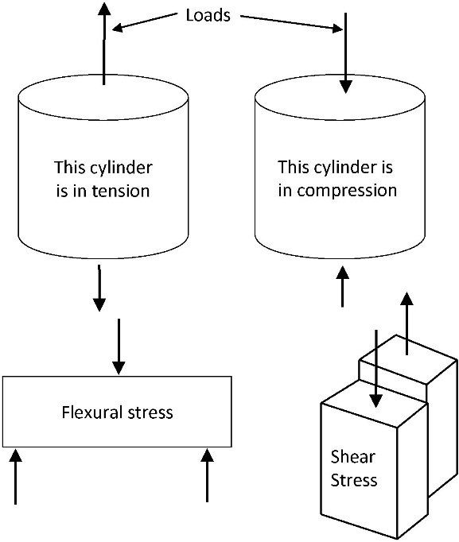
FIGURE 2.1 Compression, Tension, Flexure and Shear

Slide 2
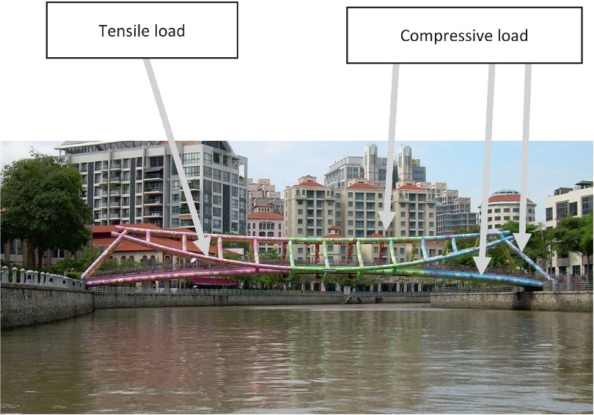
FIGURE 2.2 A Complex Bridge on the Singapore River

Slide 3
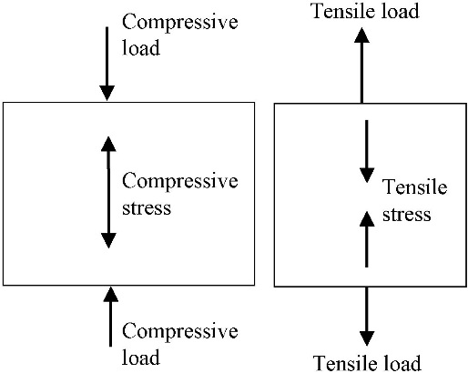
FIGURE 2.3 Load and Stress

Slide 4
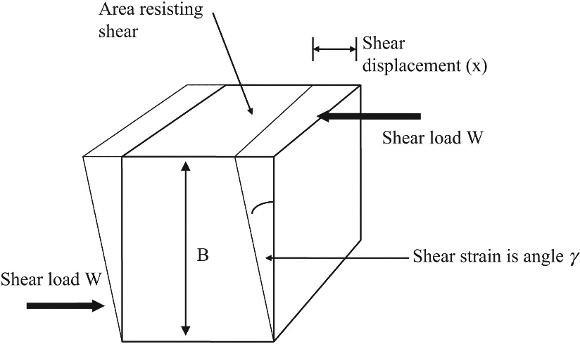
FIGURE 2.4 Shear Stress and Strain

Slide 5
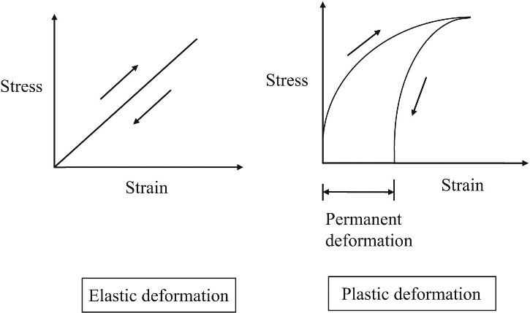
FIGURE 2.5 Elastic and Plastic Deformation

Slide 6
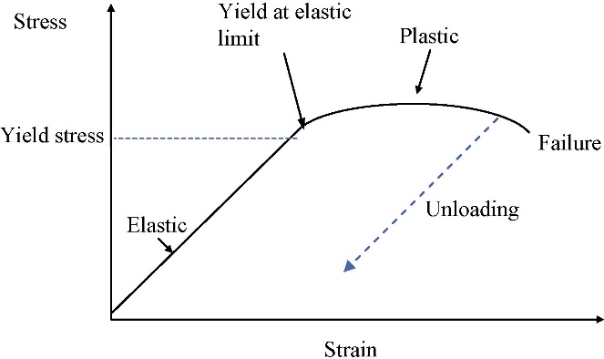
FIGURE 2.6 Elastic and Plastic Strain

Slide 7
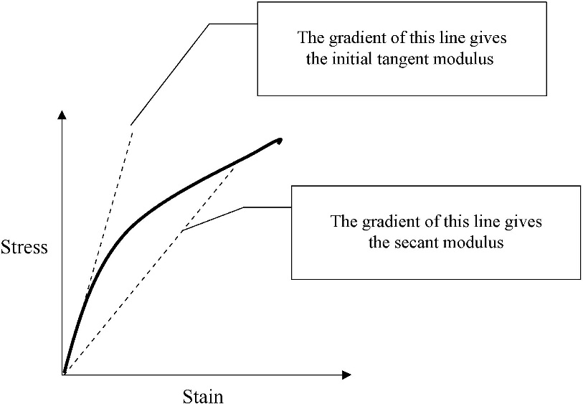
FIGURE 2.7 Tangent and Secant Modulus

Slide 8
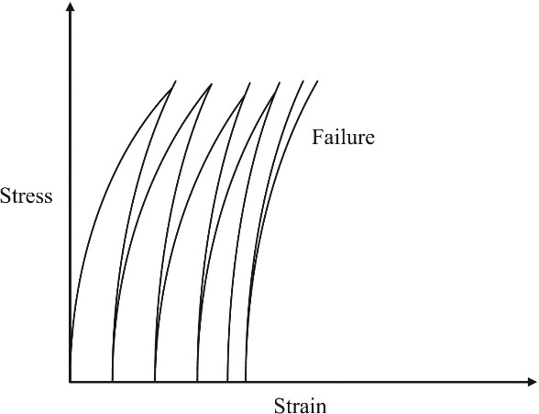
FIGURE 2.8 Fatigue Cycles to Failure

Slide 9
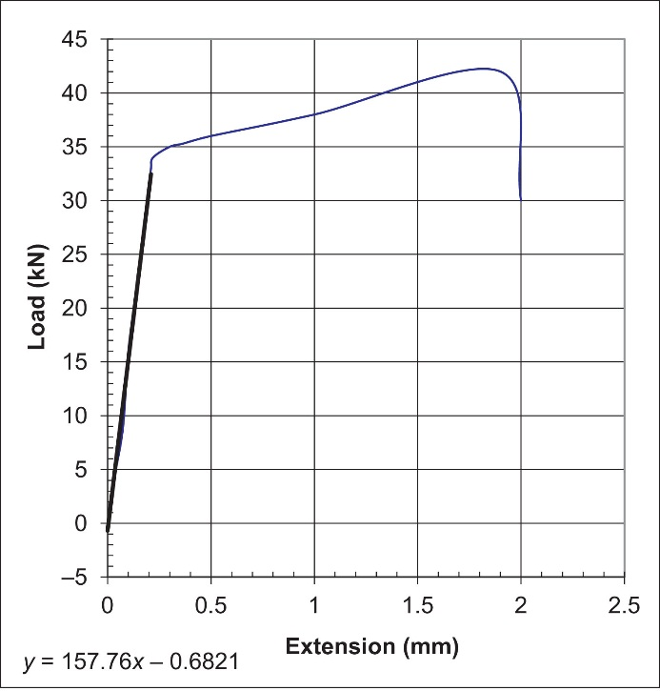

Slide 10
